Slide 1
Expense Tracker Microservice
Module: Agile & Continuous Software Engineering (Spring 2024-2025)
Student: Ioannis Tsaloumas
RN: SEY24032
Supervisor: Kostantinos Makedos

Slide 2
Tech Stack & Architecture
Python 3.10 / FastAPI
MariaDB
SQLAlchemy ORM + Pydantic validation
2‑tier micro‑architecture: web & db services
Docker‑compose orchestrates local dev env

Slide 3
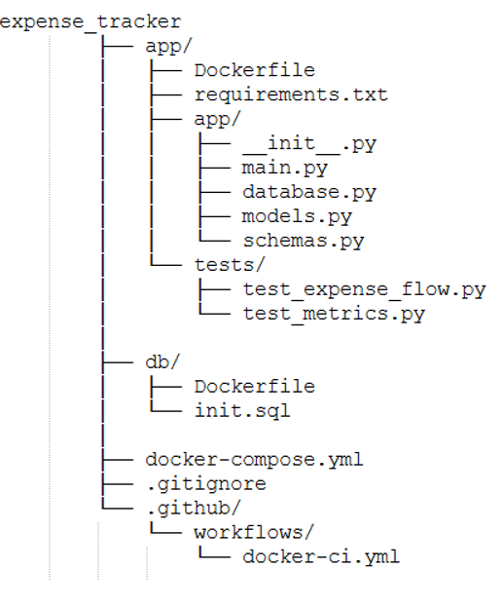
Repository Structure

Slide 4
Database Layer
db/init.sql → creates expenses table & seeds 3 sample rows
Separate db/Dockerfile builds MariaDB image with schema
app/database.py → raises EnvironmentError if DATABASE_URL is missing

Slide 5
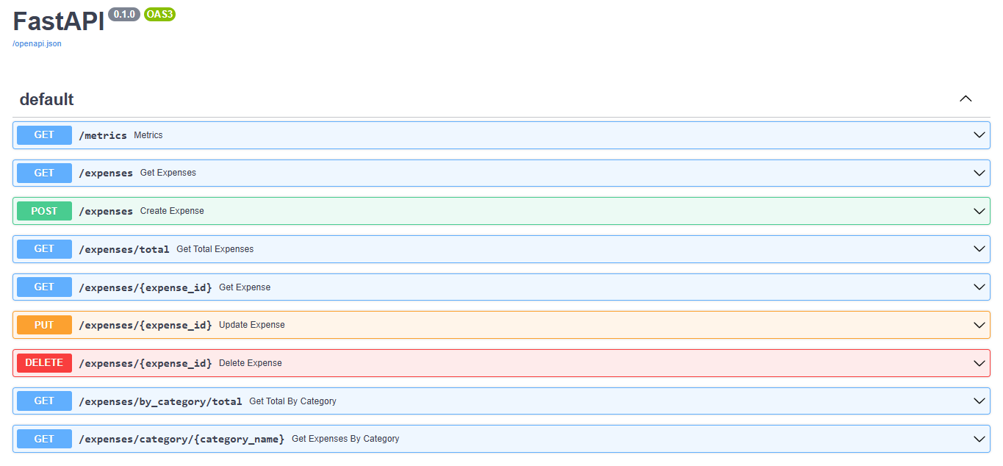
API Layer (FastAPI)
8 CRUD/analytical endpoints
POST /expenses – create
GET /expenses – list all
GET /expenses/{id} – retrieve one
PUT /expenses/{id} – update
DELETE /expenses/{id} – delete
GET /expenses/total – sum of amounts
GET /expenses/by_category/total – sum per category
GET /expenses/category/{name} – list by category
Interactive Docs via Swagger UI (/docs)
Swagger Interface

Slide 6
Containerization
app/Dockerfile
python:3.10‑slim, installs deps, exposes 8000.
db/Dockerfile
mariadb:latest, copies init.sql
docker-compose.yml
db (port 3307:3306) & web (8000:8000)
depends_on guarantees db up first

Slide 7
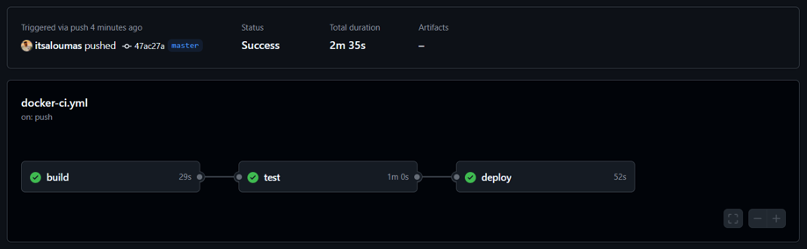
CI / CD Pipeline (GitHub Actions)
Build – cache‑only docker build on every push/PR
Test – spins up compose; runs pytest inside web.
Deploy – on merge to master: pushes image to Docker Hub with tags latest & commit SHA.

Slide 8
Testing Strategy
Pytest suite (4 tests, 100 % pass)
python:3.10‑slim, installs deps, exposes 8000.
Flow test: create → get → delete expense.
Update & category‑list tests.
Metrics endpoint test.
Seed‑data test ensures 3 default rows.

Slide 9
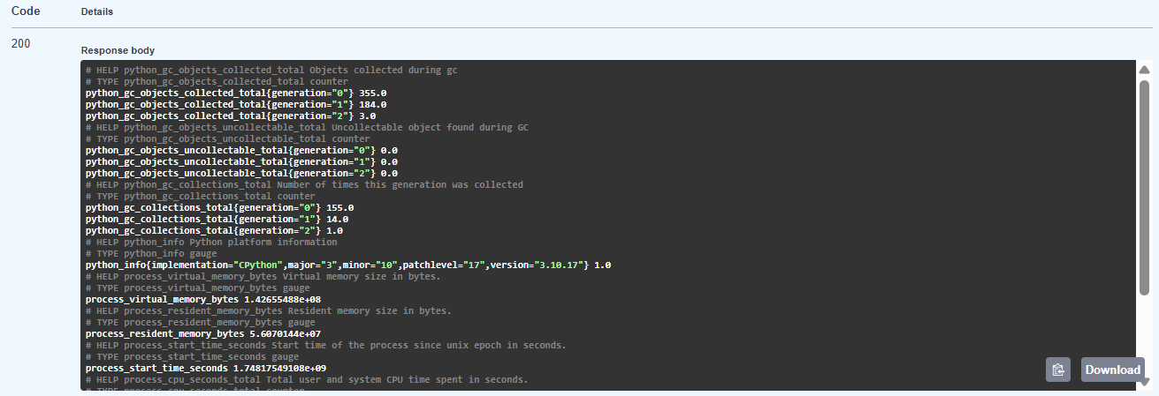
Monitoring
Prometheus counter expense_api_requests_total{method,path,status_code}
/metrics endpoint exposes default & custom metrics.

Slide 10
Live Demo
docker compose up –d
Browse to http://localhost:8000/docs
Try POST, GET, PUT, DELETE; watch /metrics
Ensure we receive status code 200 for successful GET, PUT, DELETE requests and status code 201 for successful POST requests.

Slide 11
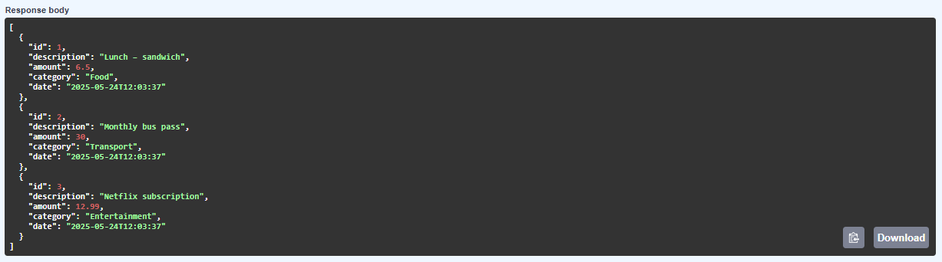
Live Demo / GET
Confirm seeded records present on first startup using the GET /expenses endpoint via Swagger

Slide 12
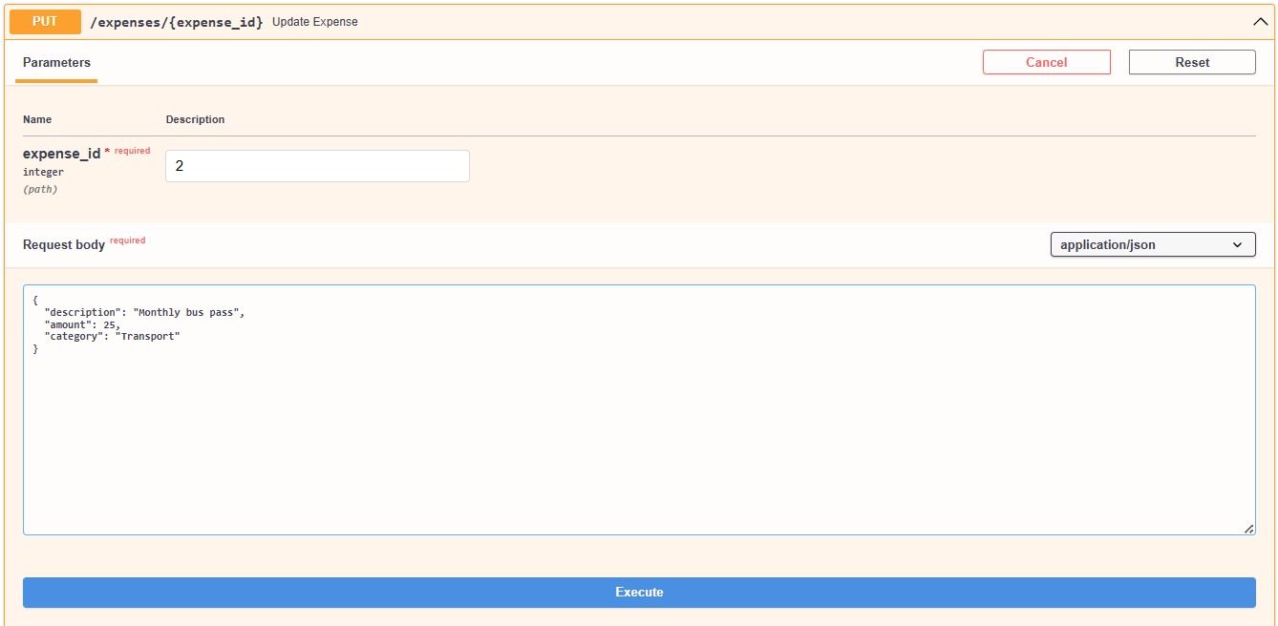
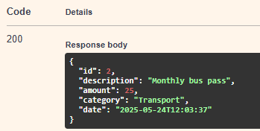
Live Demo / PUT
Update the price of Monthly bus pass using the PUT /expenses/{expense_id} endpoint setting it to 25 instead of 30

Slide 13
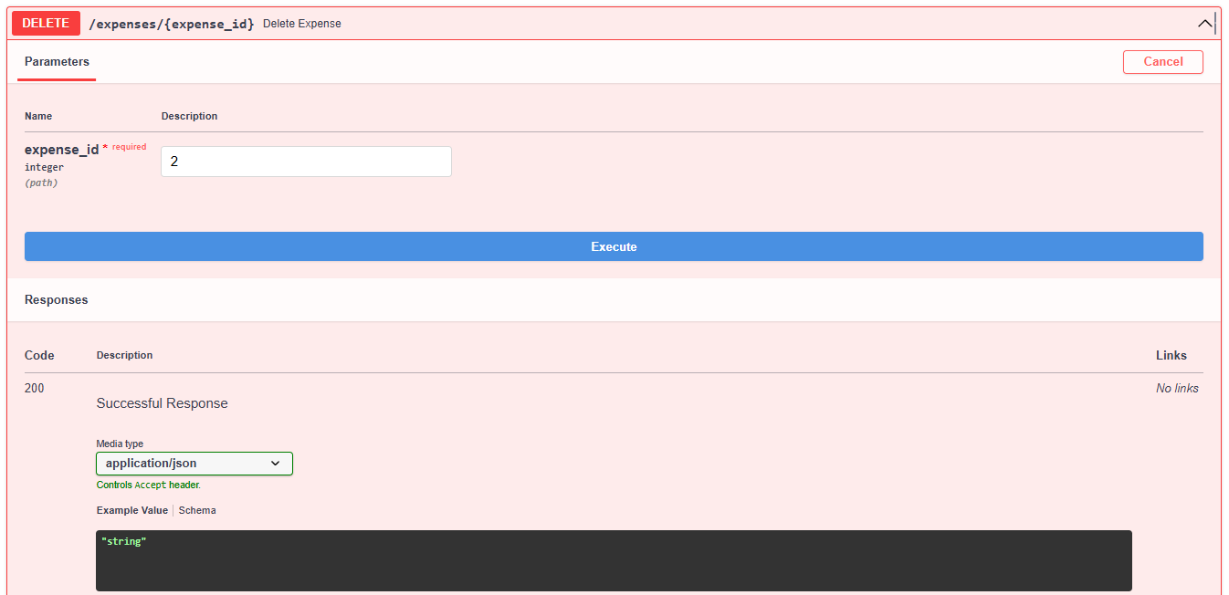
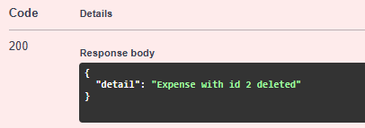
Live Demo / DELETE
Delete the expense of Monthly bus pass using the DELETE /expenses/{expense_id} endpoint

Slide 14
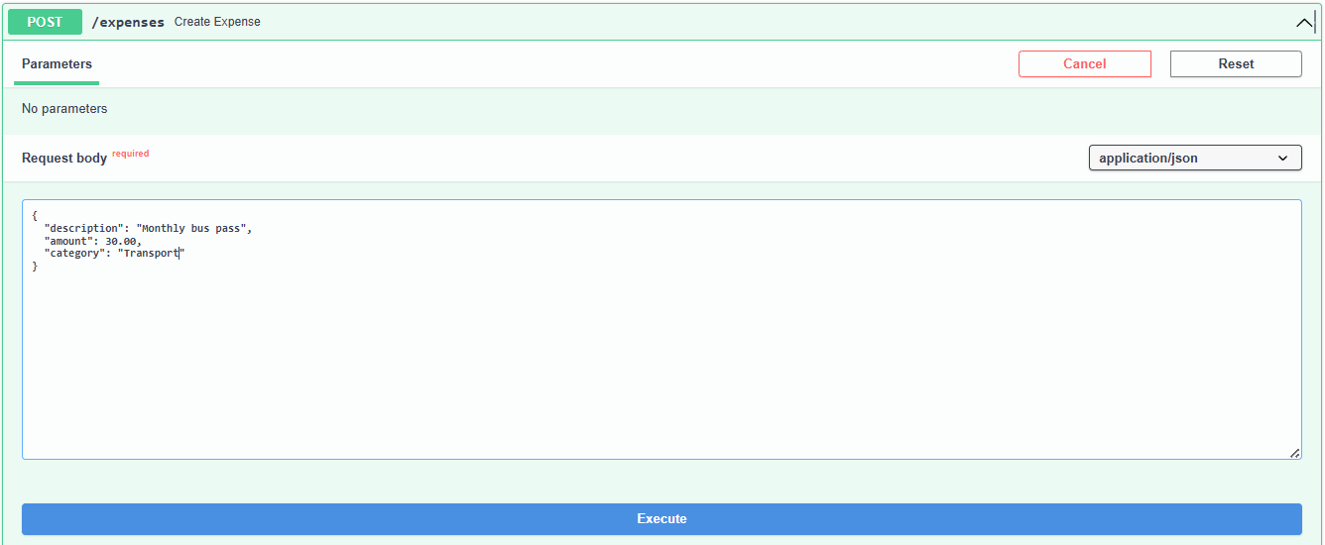
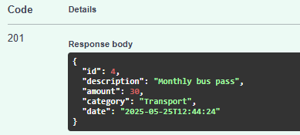
Live Demo / POST
Create the expense of Monthly bus pass, that we deleted previously using the POST /expenses endpoint

Slide 15
Future Work
Next steps: pagination, authentication, Alembic migrations, Helm chart for Kubernetes

